Slide 1

Welcome
Amber Butcher
Director of Workforce Internships
Beth Brautigan
Project Manager
Blue Ridge Community And Technical College
Martinsburg, WV
Click on this to hear audio throughout the Power Point.

Slide 2
If this is your first time with the contest, be sure to watch this video to understand the end product!
https://www.youtube.com/watch?v=1mzjc_qobT8

Slide 3
What’s so cool about manufacturing?
Be sure to double click on the slides with a photo that fills the slide – these are links to YouTube Videos!

Slide 4

Notes:
Introduction

Slide 5
Goal:
Teach students and community about careers in manufacturing .

Slide 6
New !
Who is new this year?
Due to COVID:
  Students may interview employees at the school
  Students may shoot interviews outside the manufacturer’s facility
  Must receive permission from the manufacturer to be on the premises.
  Manufacturers can provide B roll footage to help supplement the video if students are not permitted on site.

Slide 7
Regional awards
Outstanding Creativity
Viewer’s Choice
Best Manufacturing Message
Participation Certificates – All Students Will Receive A Certificate

Slide 8
New! Region winners will compete in state-wide competition.
Honorable Mentions
Best Cameo Appearance
Famous WV person – or photo of a person.
Actor, Mothman, etc.
Most Creative Product Placement
Show the product the company makes.
Best Marketing Campaign

Slide 9

Mid-October:
virtual teacher trainings
virtual introductory meeting between manufacturers and teacher coaches to start the process

Slide 10
By mid-November:
Tour & meeting at manufacturer facility
Teams create and submit draft ideas and storyboards to manufacturer partner - 7 days prior to shooting

Slide 11
By Mid-December:
Footage and interviews at manufacturing facility

Slide 12
January:
Completed draft video submitted to explore team and manufacturer partner for feedback
Mid-January - February: feedback on draft videos provided to each team

Slide 13
Final videos are due and submitted
2/25 Eastern Regional Ceremony
3/4 Kanawha Valley Regional Ceremony
3/11 North Central Regional Ceremony
3/18 Northern Regional Ceremony

Slide 14
Contest Rules & Regulations.
Projects must be completed by students with guidance and support from Teacher Coaches. Students are responsible for creative vision, directing their to capture content, creating team content, and post-production.
Each project must include student voice in the form of visual or audio segments.
Production teams must complete training as outlined in the eMedia Workshop Cool Contest Guide.
Final projects must run no longer than 3 minutes in duration.
Each video must contain a minimum of 3 employee interviews.
It is strongly recommended that students appear in the video.
Final projects must contain logos as indicated (each logo should appear for approximately 2 seconds):

Slide 15
Teacher Coaches are responsible for leading and monitoring all activities associated with contest-related activities, including being in regular contact with manufacturer and Explore Team for updates and scheduling.
The Explore Team will provide a contest timetable to Teacher Coaches and manufacturers at the Introductory Meeting.
All sound and images captured in association with the project, as well as final videos, are the property of WVMAEF.
All WVMAEF MEDIA RELEASE FORMS and a team photo must be delivered before production:
Email release forms to explore@wvma.com10.
Each team must meet contest deadlines as posted and deliver final project files to the host (details will be provided via email).
Each Teacher Coach is responsible for verifying that all unused footage has been destroyed prior to the awards ceremony.

Slide 16
Review the Contest Guide
Note: must use the video cameras, not smart phones to record

Slide 17

Video: Preproduction:
Notes:
Part 1 Introduction
Video: Preproduction

Slide 18
Prepare
Think about the audience to make it interesting.

Slide 19
The goal is to communicate careers.
What is the main point you want to communicate?
This will be determined after your initial meeting.
Examples:
    A company offers many benefits.
    Interesting and creative workplace.
    How products are made
    Where products are used
    Highlighting careers and employees
    Insights on job skills plus on-the-job training

Slide 20
Watch the next few videos for ideas!

Slide 21

Notes:
Women in Manufacturing

Slide 22

Notes:
For student training: Example of how it is important. Experts What was your central message?

Slide 23
Discuss with your students:
What do you want the audience to think, feel and do after viewing this program?

Slide 24

Notes:
Part 2 – Pre Production (Video)

Slide 25
Pre-Production
Brainstorm before going on tour
Start thinking about how you will tell a STORY!
Brainstorm story ideas

Slide 26

Notes:
Mission Impossible

Slide 27

Notes:
Tie in with school: key chain

Slide 28

Notes:
Metal Kraft – ask a question

Slide 29

Notes:
Choc Factory, relate to a cultural event

Slide 30
Pre-Production
Assign Jobs
Consider the jobs when you choose your student team!

Slide 31
Pre-Production
Producer: plans, coordinates, writes, reviews edits
Writer: writes the script
Camera: records video
Sound: oversees the sound quality
Editor: Edits the video
Other: coordinates shots/ carries equipment/ researches industry/ etc

Slide 32
Pre-Production
Research
Previous contest videos – what works/ doesn‘t work
www.whatssocool.org
Research the company:
The Manufacture’s Website/ Social Media Pages/ printed material.
Notes:
Previous videos – what works/doesn’t work. Research the company

Slide 33
Pre-Production
Before the Site Visit
Discuss what to think about and view during the tour.
Do pre-interviews before the site visit and get an idea of where/ what you can video

Slide 34
Pre-Production
Site Visit
Take photos/ videos to remember area to plan shots
Take notes of each area.
Who was interesting?
What would look interesting in a video?
After tour, review the information, brainstorm, and write notes

Slide 35
Pre-Production
Open Ended Questions
Closed-Ended Question |  | Open-Ended Question
Do you like your job? |  | Tell me about what you like about your job.
Is manufacturing cool? |  | What makes this company so cool?
Do you use robotics? |  | Can you explain how the production line works?

Slide 36
Teach the students how to make a video to tell a story.

Slide 37

Notes:
Pre-Production Watch:

Slide 38

Notes:
Pre Production: Show to your students: Sequencing video on story telling

Slide 39
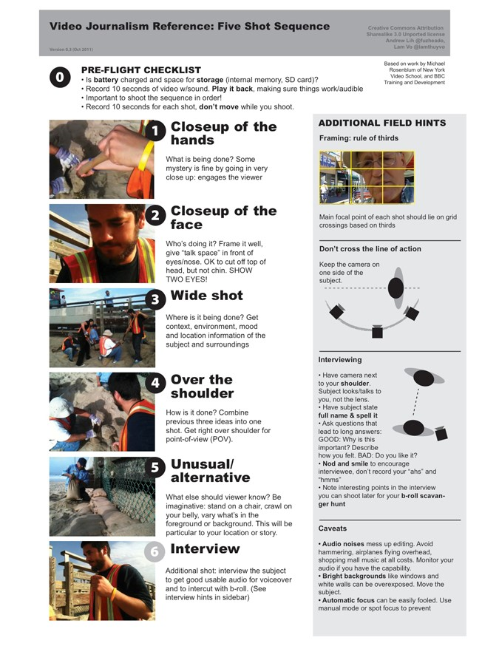

Slide 40
Pre-Production
Practice using the camera.
Have students sequence making a sandwich and tying shoes.
Edit the practice material – it will make videoing easier once you understand editing!

Slide 41

Notes:
Part III Production: Video Preproduction:

Slide 42
Production
A Roll:
Interview footage
Consider background – people, machines, lights
Have one student jot down main points during the interview so you can plan to video it. Video what they say!

Slide 43

Notes:
Learning from others to avoid mistakes. What are the Pro’s and Con’s of the video

Slide 44
Production
B Roll:
Non interview footage
Record the background noise
Record 20 minutes for every one minute of final footage
If the interviewer says it, shoot it!

Slide 45
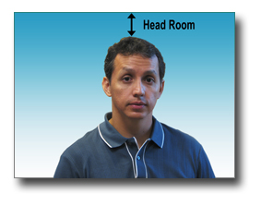
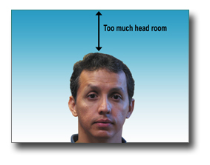
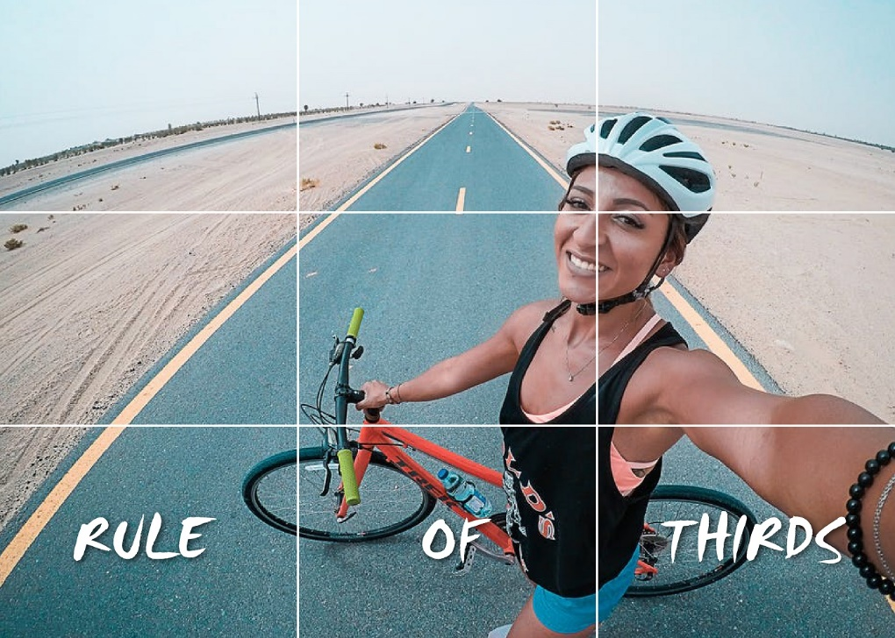
Production
Get enough video for flexibility
Rule of thirds
Headroom
Straight-on interviews -- camera at eye level or slightly above eye level (above your shoulder)
Don’t shoot from too low.
Credit: https://www.asu.edu/alti/ltlab/tutorials/video/basics/comp1_hdrm.htm
https://www.colorexpertsbd.com/blog/how-to-take-selfie-like-a-model
Notes:
Next page for example

Slide 46


Slide 47
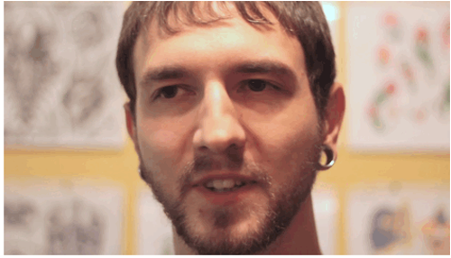
Production
Lighting
Window light coming from in front of or slightly off to the side of a subject is good, so turn the subject toward an open window.
Turn off overhead lights if possible (office environment with a window).
Look for shadows under eyes.

Slide 48

Notes:
Production – shoot the interview first, then the b-roll. “If they say it, shoot it”. CONTEST EXAMPLE. Use the storyboard so that you know what kind of shots you will need. Plan as much in advance as possible to save time.

Slide 49
Audio
Interview:
Listen for background sounds that can ruin the interview: people talking, machines clanging, forklifts beeping – noise that makes it hard to hear the speaker.
Ask for a quiet place to do the interview.
At the same time, the ambient sound can ADD to the interview and make the audience feel like they are at the factory.

Slide 50
Audio
PRACTICE WITH MIC PLACEMENT.
Placing it on a table may result in poor sound
Test the audio at the beginning of each interview

Slide 51
Tips to consider when interviewing:
Give questions in advance.
Practice with interviewee before recording.
Don’t be afraid to ask the person to expand on answer, give a more brief answer, talk slower, talk louder, etc.

Slide 52

Notes:
Other tips> 1. Look for a tie-in with the school. 2. Search for “gems” – fun elements or stories. 3. Get the students in the video. Students, interview, touring facility, participating in a skit.4. Get your school logo/name/picture in the video. 5. Have the students wear logo’d items from school or company. 6. Be creative and Have FUN!

Slide 53

Notes:
Students getting to do hands on is great in this video!

Slide 54
Challenge
If you can’t use video:
https://www.whatssocool.org/previous-contests/berks-schuykill-2021/
Notes:
Challenge - If you can't use video:

Slide 55

Notes:
Editing – always keep a copy of unedited footage stored separately. Plan – What A roll and B roll footage you will use. Will you use a voice over? (student narrating the video)

Slide 56
Editing
Place A roll footage on timeline
Add the B roll to show what the speaker is talking about.
Switch shots every 2-3 seconds, combined with a few longer shots
Consider ambient sound you will keep
Add Voice Over
Add music.
Adjust level of music to hear the narration or ambient sound
Ask your county Public Information Officer/ Digital Media teachers

Slide 57
Editing
Use Royalty-free music with no vocals
    http://www.incompetech.com/music/royalty-free/
    https://vimeo.com/musicstore- search for "Creative Commons" license and "Instrumentals Only."
Consult the Rules and Regulations

Slide 58
Editing Software
Adobe Premiere (monthly subscription price)
https://helpx.adobe.com/premiere-pro/tutorials.html
Lightworks (free download)
https://www.youtube.com/watch?v=-VLCg18VxfU&vl=en
imovie

Slide 59
Marketing Plan
Brainstorm how you can get others to show the video!
Ask the communications director to share the videos on social media and in the schools.

Slide 60
Questions?

